Slide 1
Supervised Learning

Slide 2
Machine Learning
Machine learning is a subfield of artificial intelligence (AI) that focuses on the development of algorithms and models that allow computers to learn from and make predictions or decisions based on data.
Machine learning enables computers to learn from data and improve their performance over time without being explicitly programmed.

Slide 3
Application of ML
Predictive Analytics – Sales forecasting, demand prediction
Natural Language Processing (NLP)- Interaction between computer and human
Computer Vision - Object detection, image classification.
Healthcare – disease diagnostic, medical imaging analysis
Finance – credit scoring, risk management
Manufacturing and Industry – quality control, supply chain optimization
Energy Management – consumption prediction, demand forecasting.

Slide 4
Supervised Learning
Supervised learning is a type of machine learning where the algorithm is trained on a labeled dataset
It means the input data is paired with the correct output.
The goal of supervised learning is to learn a mapping from inputs to outputs so that it can make predictions or decisions when we give new, unseen data.
Example: Image classification, Risk Assessment Fraud Detection, spam filtering

Slide 5
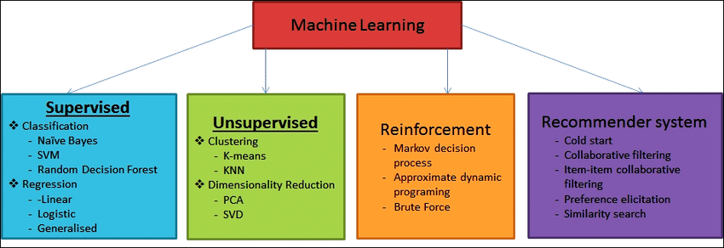

Slide 6
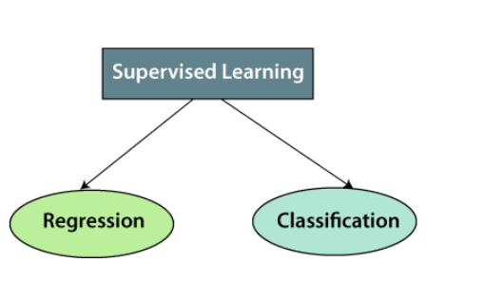
Types of supervised Machine learning Algorithms

Slide 7
Regression
Regression is a method for understanding the relationship between independent variables or features and a dependent variable or outcome.
Regression algorithms are used if there is a relationship between the input variable and the output variable. It is used for the prediction of continuous variables, such as Weather forecasting, Market Trends, etc. Below are some popular Regression algorithms that come under supervised learning:
Linear Regression
Regression Trees
Non-Linear Regression
Bayesian Linear Regression
Polynomial Regression

Slide 8
Classification
Classification algorithms are used when the output variable is categorical, which means there are two classes such as Yes-No, Male-Female, True-false, etc.
Spam Filtering,
Random Forest
Decision Trees
Logistic Regression
Support vector Machines

Slide 9
Advantages of Supervised learning:
With the help of supervised learning, the model can predict the output on the basis of prior experiences.
In supervised learning, we can have an exact idea about the classes of objects.
Supervised learning model helps us to solve various real-world problems such as fraud detection, spam filtering, etc.

Slide 10
Disadvantages of supervised learning:
Supervised learning models are not suitable for handling complex tasks.
Supervised learning cannot predict the correct output if the test data is different from the training dataset.
Training required lots of computation time.
In supervised learning, we need enough knowledge about the classes of objects.

Slide 11
Linear Regression
Linear regression is one of the easiest and most popular Machine Learning algorithms.
Linear regression makes predictions for continuous/real or numeric variables such as sales, salary, age, product price, etc.
Linear regression algorithm shows a linear relationship between a dependent (y) and one or more independent (x) variables, hence called as linear regression.
Since linear regression shows the linear relationship, which means it finds how the value of the dependent variable is changing according to the value of the independent variable.

Slide 12
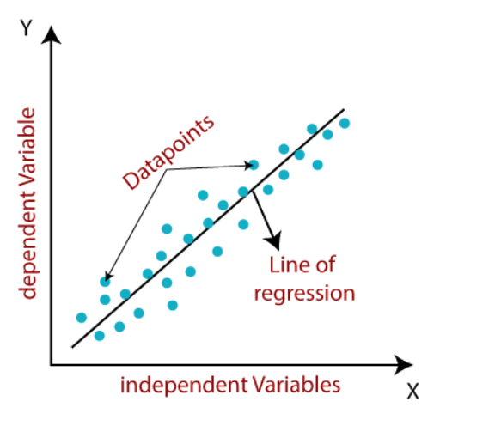

Slide 13
y= a₀+a₁x+ ε
Here
Y= Dependent Variable (Target Variable)
X= Independent Variable (predictor Variable)
a₀= intercept of the line (Gives an additional degree of freedom)
a₁ = Linear regression coefficient (scale factor to each input value).
ε = random error

Slide 14
Naive Bayes Classifier
Naïve Bayes algorithm is a supervised learning algorithm, which is based on Bayes theorem and used for solving classification problems.
It is mainly used in text classification
Naïve Bayes Classifier is one of the simplest and most effective Classification algorithms that help in building fast machine learning models that can make quick predictions.
It is a probabilistic classifier, which means it predicts results based on the probability of an object.
Example: Classifying Articles

Slide 15
Why is it called Naïve Bayes?
It is called Naïve because it assumes that the occurrence of a certain feature is independent of the occurrence of other features.
Such as if the fruit is identified based on color, shape, and taste, then red, spherical, and sweet fruit is recognized as an apple. Hence each feature individually contributes to identify that it is an apple without depending on each other.
Hence each feature individually contributes to identify that it is an apple without depending on each other.
Bayes: It is called Bayes because it depends on the principle of Bayes' Theorem.

Slide 16

Baye’s Theorem
P(A|B) = The probability of A given B is true
P(B|A) = The probability of B given A is true
P(A), P(B) = The independent probabilities of A and B
A, B = Events

Slide 17
Problem
Problem: If the weather is sunny, then the Player should play or not?

Slide 18
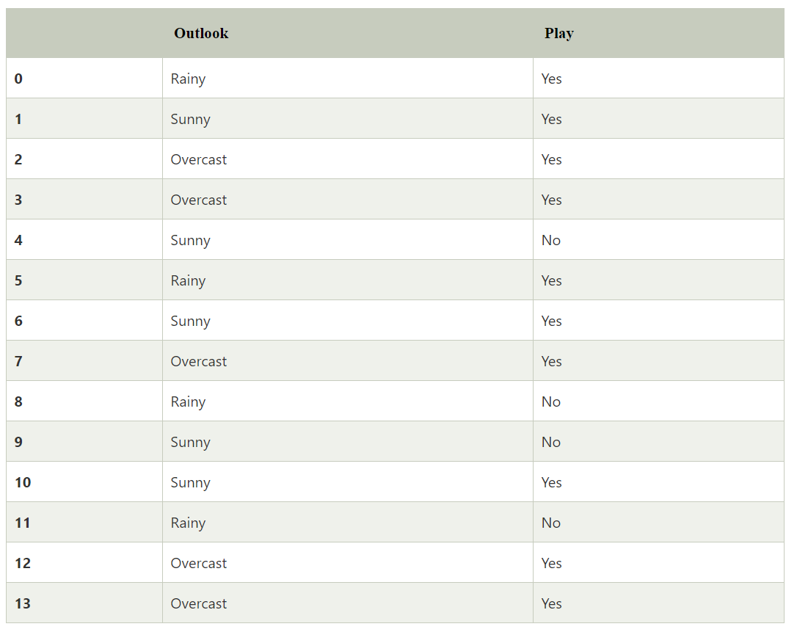

Slide 19
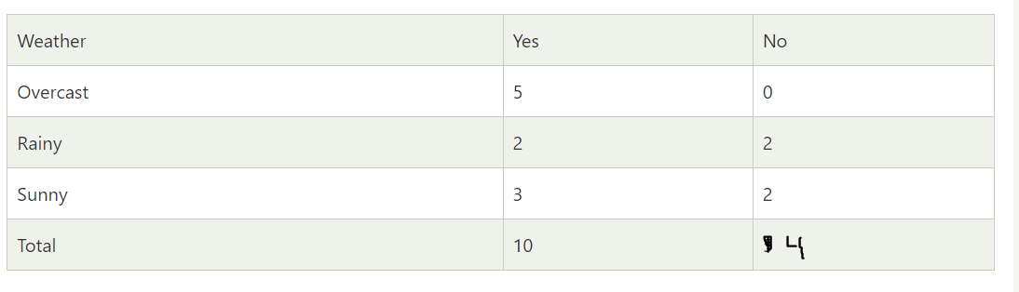

Slide 20
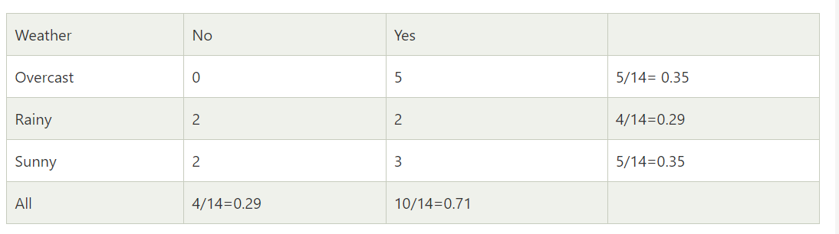

Slide 21
P(Yes|Sunny)= P(Sunny|Yes)*P(Yes)/P(Sunny)
P(Sunny|Yes)= 3/10= 0.3
P(Sunny)= 0.35
P(Yes)=0.71
So P(Yes|Sunny) = 0.3*0.71/0.35= 0.60

Slide 22
P(No|Sunny)= P(Sunny|No)*P(No)/P(Sunny)
P(Sunny|NO)= 2/4=0.5
P(No)= 0.29
P(Sunny)= 0.35
So P(No|Sunny)= 0.5*0.29/0.35 = 0.41
So as we can see from the above calculation that P(Yes|Sunny) > P(No|Sunny)

Slide 23
KNN( K–Nearest Neighbor)
K-Nearest Neighbour is one of the simplest Machine Learning algorithms based on Supervised Learning techniques.
The K-NN algorithm assumes the similarity between the new case/data and available cases and puts the new case into the category that is most similar to the available categories.
The KNN Algorithm is used for pattern recognition, data mining, and intrusion detection.
The K-NN algorithm works by finding the K nearest neighbors to a given data point based on a distance metric, such as Euclidean distance.

Slide 24
It is also called a lazy learner algorithm because it does not learn from the training set immediately instead it stores the dataset and at the time of classification, it performs an action on the dataset.
The KNN algorithm at the training phase just stores the dataset and when it gets new data, then it classifies that data into a category that is much similar to the new data.
K-NN is a non-parametric algorithm, which means it does not make any assumption on underlying data.

Slide 25
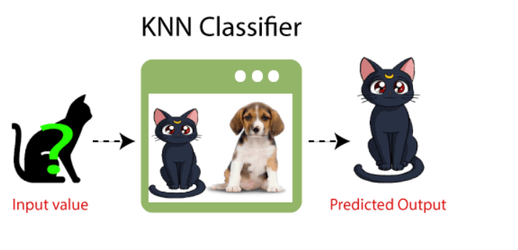
Example
Suppose, we have an image of a creature that looks similar to cat and dog, but we want to know whether it is a cat or a dog. So for this identification, we can use the KNN algorithm, as it works on a similarity measure. Our KNN model will find the similar features of the new data set to the cats and dogs images and based on the most similar features it will put it in either the cat or dog category.

Slide 26
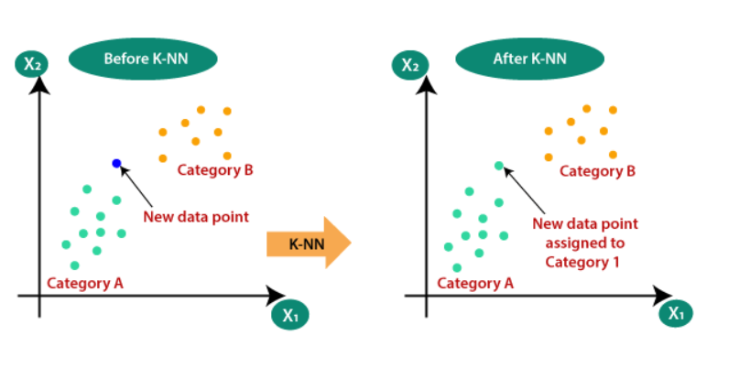
Why do we need a K-NN Algorithm?
Suppose there are two categories, i.e., Category A and Category B, and we have a new data point x1, so this data point will lie in which of these categories. To solve this type of problem, we need a K-NN algorithm. With the help of K-NN, we can easily identify the category or class of a particular dataset.

Slide 27
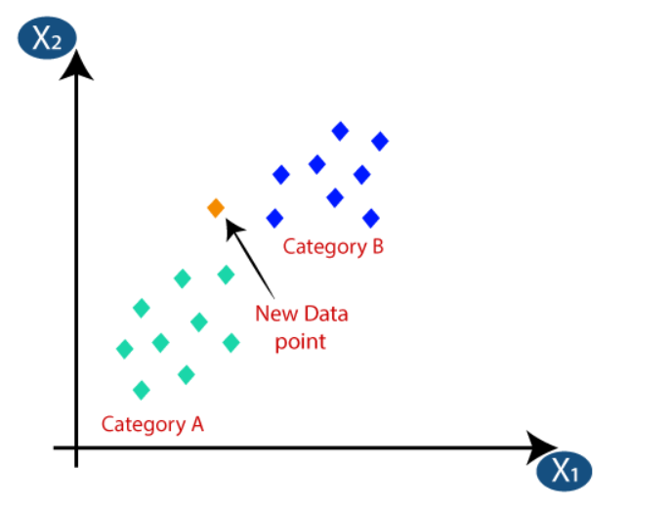
Problem
Suppose we have a new data point and we need to put it in the required category. Consider the below image:

Slide 28
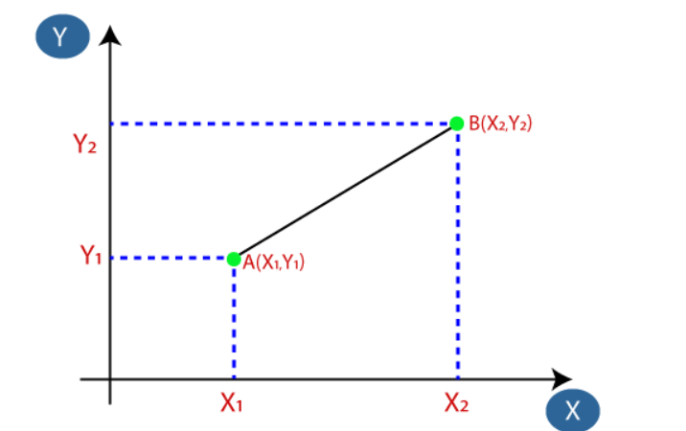

Step 1: Firstly, we will choose the number of neighbors, so we will choose the k=5
Step 2: Next, we will calculate the Euclidean distance between the data points.

Slide 29
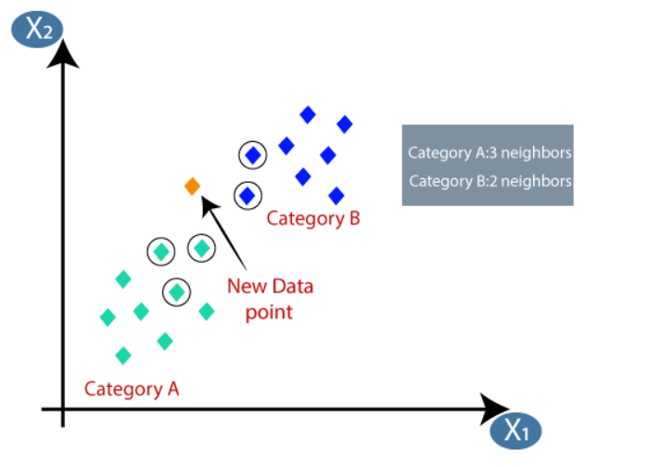
Step 3: By calculating the Euclidean distance we got the nearest neighbors, as three nearest neighbors in category A and two nearest neighbors in category B.

Slide 30
Step 4: As we can see the 3 nearest neighbors are from category A, hence this new data point must belong to category A.

Slide 31
How to select the value of K in the K-NN Algorithm?
There is no particular way to determine the best value for "K", so we need to try some values to find the best out of them. The most preferred value for K is 5.
A very low value for K such as K=1 or K=2, can be noisy and lead to the effects of outliers in the model.
Large values for K are good, but it may find some difficulties.

Slide 32
Logistic Regression
Logistic regression is a supervised learning algorithm used to predict a dependent categorical target variable.
In essence, if you have a large set of data that you want to categorize, logistic regression may be able to help.
Logistic regression predicts the output of a categorical dependent variable. Therefore the outcome must be a categorical or discrete value. It can be either Yes or No, 0 or 1, true or False.
However instead of giving the exact value as 0 and 1, it gives the probabilistic values which lie between 0 and 1.

Slide 33
Logistic Regression is very similar to Linear Regression except for how they are used. Linear Regression is used for solving Regression problems, whereas Logistic regression is used for solving the classification problems.
In Logistic regression, instead of fitting a regression line, we fit an "S" shaped logistic function, which predicts two maximum values (0 or 1).

Slide 34
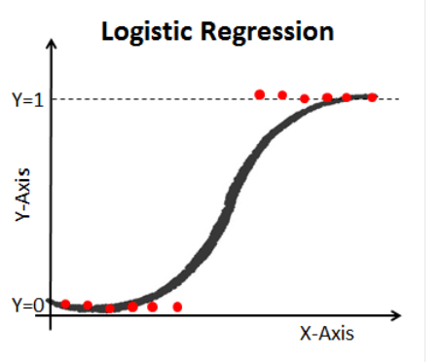

Slide 35
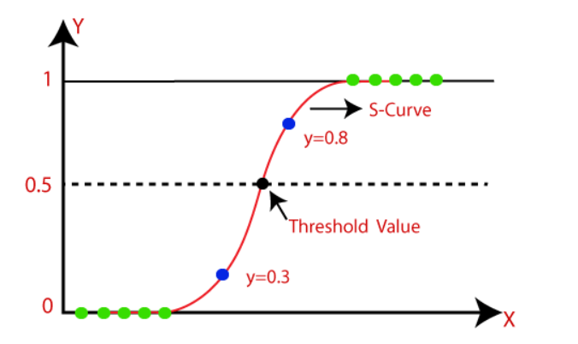

Slide 36
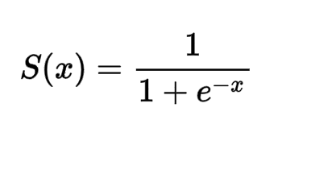
Function
S(x) = Sigmoid Function
e = Euler’s Number
The sigmoid function is also called a squashing function as its domain is the set of all real numbers, and its range is (0, 1).

Slide 37
Assumptions of Logistic Regression
The assumptions include:
Independent observations: Each observation is independent of the other. meaning there is no correlation between any input variables.
No outliers: There should be no outliers in the dataset.
Large sample size: The sample size is sufficiently large.

Slide 38
Type of Logistic Regression:
Binomial: In binomial Logistic regression, there can be only two possible types of dependent variables, such as 0 or 1, Pass or Fail, etc.
Multinomial: In multinomial Logistic regression, there can be 3 or more possible unordered types of the dependent variable, such as "cat", "dogs", or "sheep"
Ordinal: In ordinal Logistic regression, there can be 3 or more possible ordered types of dependent variables, such as "low", "Medium", or "High".

Slide 39
Application of Logistic Regression
Credit Scoring
Medicine
Text Editing - Toxic speech detection, topic classification for questions to support, and email sorting are examples where logistic regression shows good results.
Hotel Booking
Gaming

Slide 40
Decision Tree
Decision Tree is a Supervised learning technique that can be used for both classification and Regression problems, but mostly it is preferred for solving Classification problems.
It is a tree-structured classifier, where internal nodes represent the features of a dataset, branches represent the decision rules and each leaf node represents the outcome.
In a Decision tree, there are two nodes, which are the Decision Node and Leaf Node. Decision nodes are used to make any decision and have multiple branches, whereas Leaf nodes are the output of those decisions and do not contain any further branches.

Slide 41
It is a graphical representation for getting all the possible solutions to a problem/decision based on given conditions.

Slide 42
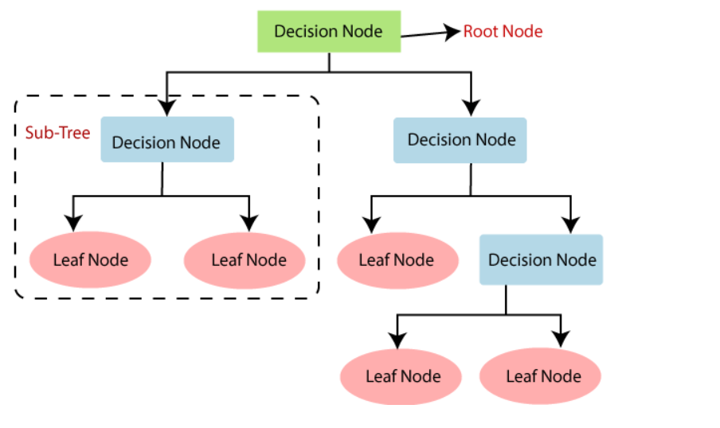

Slide 43
Why use Decision Trees?
There are various algorithms in Machine learning, so choosing the best algorithm for the given dataset and problem is the main point to remember while creating a machine learning model. Below are the two reasons for using the Decision tree:
Decision Trees usually mimic human thinking ability while making a decision, so it is easy to understand.
The logic behind the decision tree can be easily understood because it shows a tree-like structure.

Slide 44
Example
Suppose there is a candidate who has a job offer and wants to decide whether he should accept the offer or Not. So, to solve this problem, the decision tree starts with the root node (Salary attribute). The root node splits further into the next decision node (distance from the office) and one leaf node based on the corresponding labels. The next decision node further gets split into one decision node (Cab facility) and one leaf node. Finally, the decision node splits into two leaf nodes (Accepted offers and Declined offer).
Notes:
Attribute Selection Measure (ASM).

Slide 45
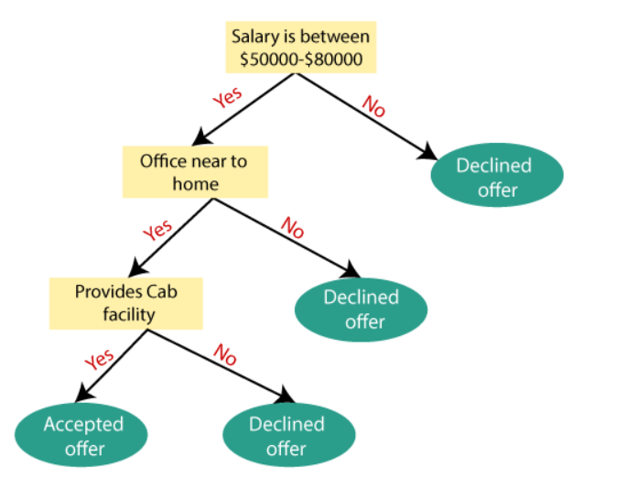

Slide 46
Quiz
What Are the Different Types of Machine Learning?
Identify the type of learning in which labeled training data is used.
Semi Supervised Learning
Supervised Learning
Unsupervised Learning

Slide 47
Question
Machine learning is a subset of which of the following.
Artificial Intelligence
Deep Learning
Data Learning
None of these

Slide 48
Which of the following are common classes of problems in machine learning?
Regression
Classification
Clustering
All of the above

Slide 49
Question
What does K stands for in KNN Algorithm
What Is ‘naive’ in the Naive Bayes Classifier?
When Will You Use Classification over Regression?
Explain the K Nearest Neighbor Algorithm.

Slide 50
Random Forest Algorithm
Random Forest or Random Decision Tree
Random Forest algorithm is a powerful tree-learning technique in Machine Learning. It works by creating a number of Decision Trees during the training phase.
Each tree is constructed using a random subset of the data set to measure a random subset of features.

Slide 51
This reduces the risk of overfitting and improving overall prediction performance.
In prediction, the algorithm aggregates the results of all trees, either by voting (for classification tasks) or by averaging (for regression tasks).
Random Forest is known for their ability to handle complex data, reduce overfitting, and provide reliable forecasts in different environments.

Slide 52
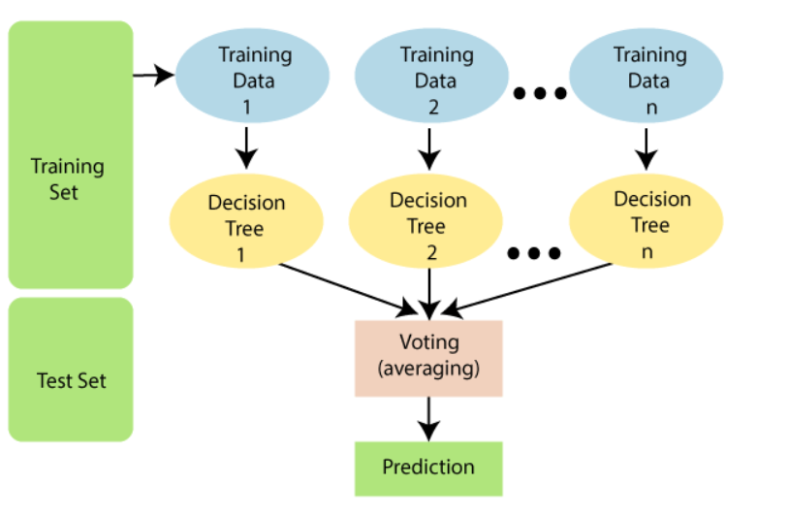

Slide 53
Why use Random Forest?
It takes less training time as compared to other algorithms.
It predicts output with high accuracy, even for the large dataset it runs efficiently.
It can also maintain accuracy when a large proportion of data is missing.

Slide 54
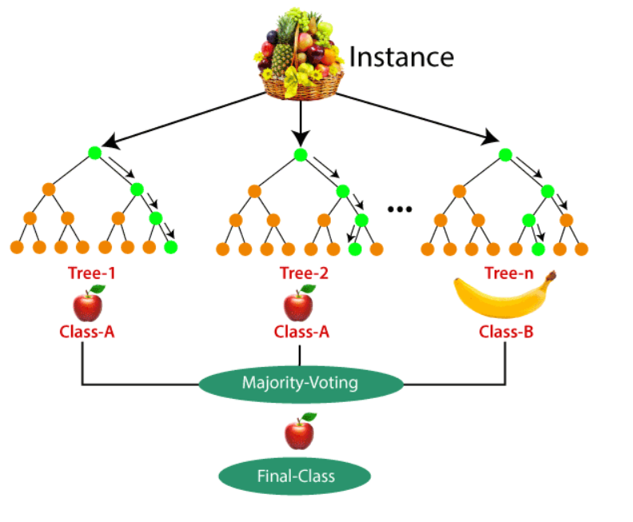

Slide 55
Support Vector Machine(SVM)
Support Vector Machine (SVM) is a powerful machine learning algorithm used for classification, regression, and even outlier detection tasks.
SVMs can be used for a variety of tasks, such as text classification, image classification, spam detection, handwriting identification, gene expression analysis, face detection, and anomaly detection.

Slide 56
SVM
The goal of the SVM algorithm is to create the best line or decision boundary that can segregate n-dimensional space into classes so that we can easily put the new data point in the correct category in the future.
This best decision boundary is called a hyperplane.

Slide 57
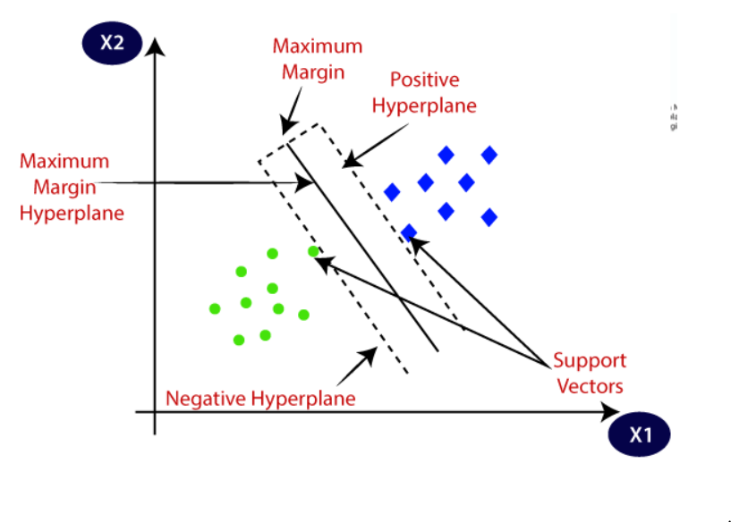

Slide 58
SVM chooses the extreme points/vectors that help in creating the hyperplane. These extreme cases are called as support vectors, and hence algorithm is termed as Support Vector Machine.

Slide 59
Hyperplane
There can be multiple lines/decision boundaries to segregate the classes in n-dimensional space, but we need to find out the best decision boundary that helps to classify the data points. This best boundary is known as the hyperplane of SVM.
The dimensions of the hyperplane depend on the features present in the dataset, which means if there are 2 features , then the hyperplane will be a straight line. And if there are 3 features, then the hyperplane will be a 2-dimension plane.

Slide 60
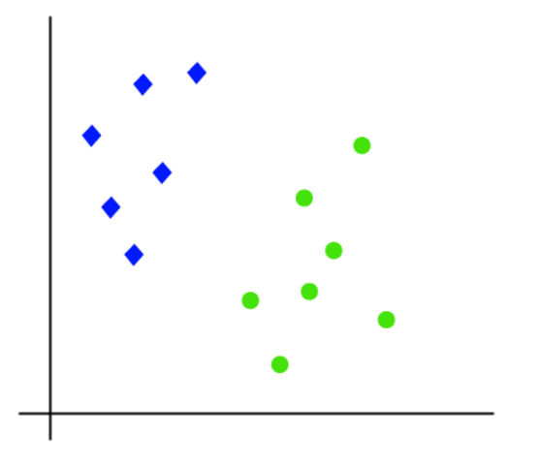
The working of the SVM algorithm can be understood by using an example. Suppose we have a dataset that has two tags (green and blue), and the dataset has two features x1 and x2. We want a classifier that can classify the pair(x1, x2) of coordinates in either green or blue.

Slide 61
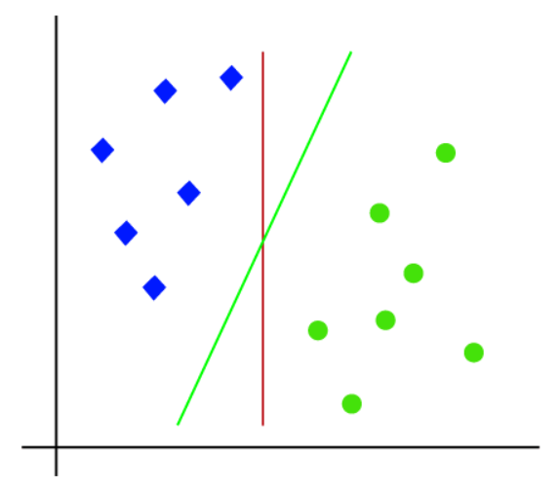
So as it is 2-d space so by just using a straight line, we can easily separate these two classes. But there can be multiple lines that can separate these classes.

Slide 62
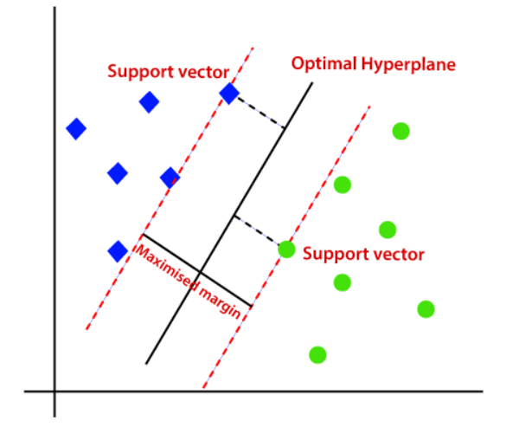
The SVM algorithm helps to find the best line or decision boundary; this best boundary or region is called as a hyperplane. SVM algorithm finds the closest point of the lines from both the classes. These points are called support vectors. The distance between the vectors and the hyperplane is called as margin.

Slide 63
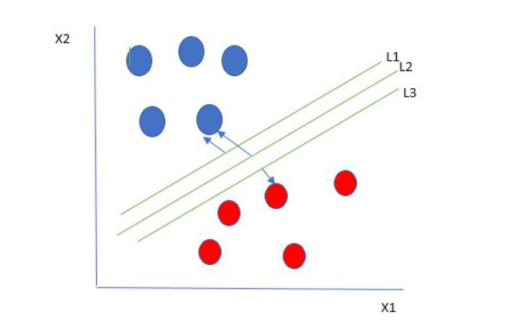
One reasonable choice as the best hyperplane is the one that represents the largest separation or margin between the two classes.
So we choose the hyperplane whose distance from it to the nearest data point on each side is maximized. If such a hyperplane exists it is known as the maximum-margin hyperplane/hard margin.

